Slide 1
CAMPAIGN TO END
CHILD POVERTY
The League of Women Voters of Ashland & Bayfield Counties

Slide 2
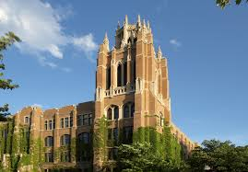
Starting at Marquette University
in 2014

Slide 3
2 faith-based networks
WISDOM
Wisconsin Council of Churches

Slide 4
and 2 policy groups
Kids Forward
(Formerly the Wisconsin Council on Children and Families)
Citizen Action of Wisconsin Education Fund

Slide 5
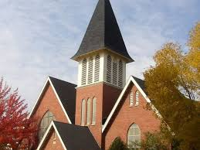
hosted a path breaking 2 year conversation on poverty
24 major forums at churches & other religious settings
In every region of Wisconsin
Over 1,200 participants

Slide 6
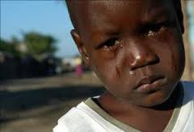
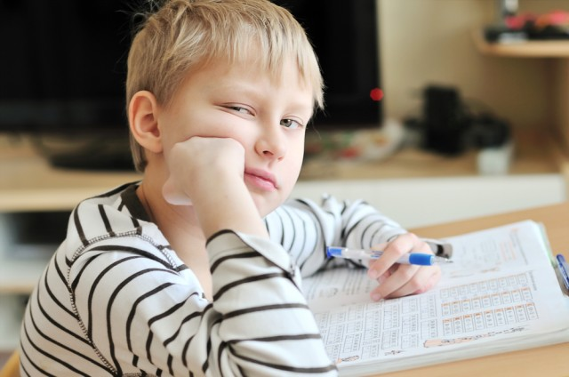
we dug into the facts
who is poor
how prevalent is poverty
racial inequality
causes of poverty
history of efforts to reduce poverty

Slide 7
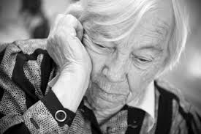
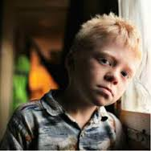
we discovered that children are now the poorest Americans
in the 1950s seniors were the poorest group
children were the second poorest group
poverty for both was cut dramatically by public investments
investments in seniors continued….
investments in children tapered off….
seniors now have the lowest rate of poverty
but children are the poorest group in America today

Slide 8
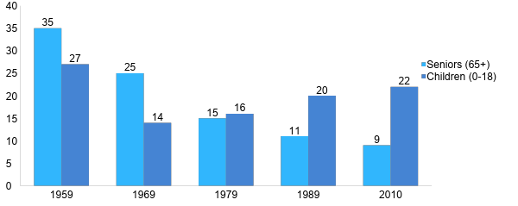
% Poverty Over Time: 1959-2010 Children and Seniors
Sachs JD. The Price of Civilization. 2011, Random House, NY. Chapter 10, pp. 185-208
Notes:
It wasn’t always like this. A half century ago, the elderly were the social group with the highest rate of poverty (35% in 1959). Then came expansion of Social Security and introduction of Medicare, it plummeted to 25 in 1969, etc. The pattern for children was a different story. It dropped from 27 % to 14% in the 60s due to Medicaid and other social support, but began a gradual long-term climb so that now more than 1 in 5 children grows up in poverty. Government can work and we have made decisions as a society to support the elderly, but not to the same degree children. BTW, if we take these benefits away from seniors, their poverty level would increase 5-fold, back up to 1959 levels.
So when people say there is nothing we can do – this level of poverty is inevitable within a capitalist society – there are winners and losers – get used to it
I respond – look what we did for seniors. We made a choice. We could make the same choice for kids. We must make that choice – the future of our economy depends on it

Slide 9
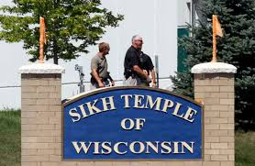
in discussions across the spectrum of faiths
we found that child poverty is expanding in every region of Wisconsin

Slide 10
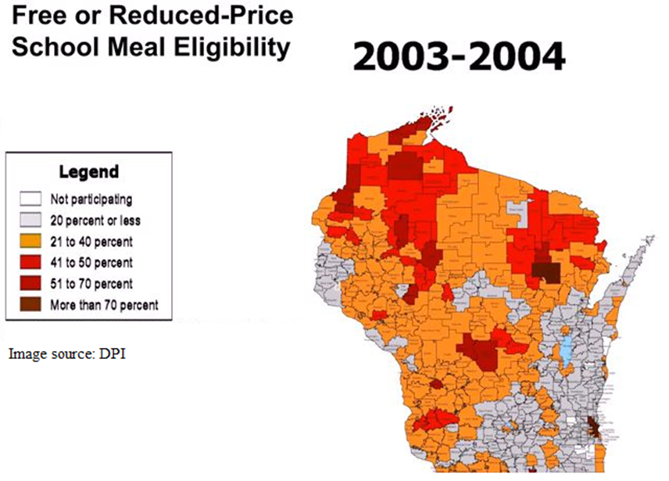
Notes:
We can see what this has meant for areas of our state by comparing maps of Wisconsin school districts that offer free or reduced-price school meals. The lighter areas have a lower percentage of students that are eligible for meals, the darker areas have a higher percentage, up to over 70%.

Slide 11
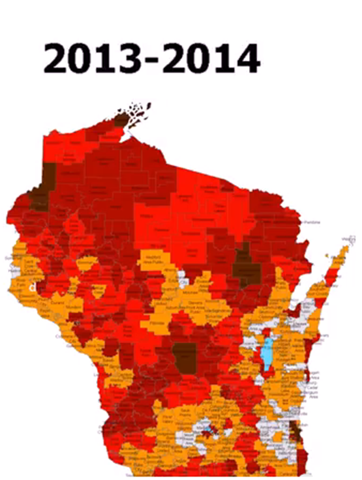
Notes:
We can see what this has meant for areas of our state by comparing maps of Wisconsin school districts that offer free or reduced-price school meals. The lighter areas have a lower percentage of students that are eligible for meals, the darker areas have a higher percentage, up to over 70%.

Slide 12
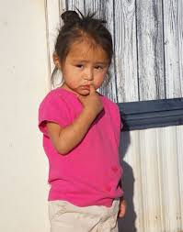
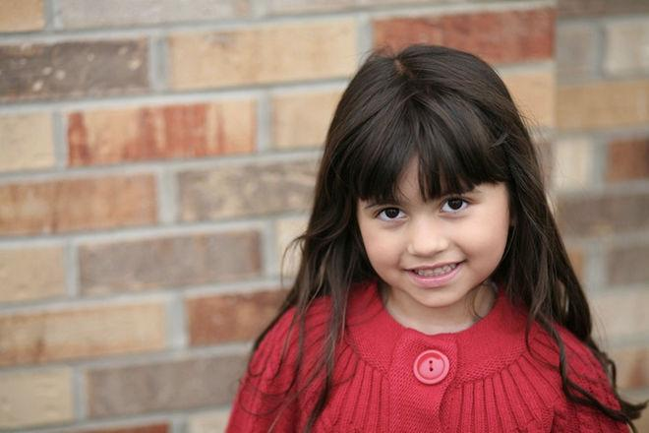
we found racial disparities are dramatic between our Wisconsin kids
In WISCONSIN…
compared to white kids
African American kids are almost 5x more likely to be poor
Latino kids are 3x more likely to be poor
Native American kids are 4x more likely to be poor
….and the poverty rate for our African American kids is 8% above the national average for black child poverty

Slide 13
In addition, we learned that:
children are the poorest segment of Wisconsin
Wisconsin has among the worst racial disparities
pulling children out of poverty makes the biggest difference in life prospects
to help children you must help their families

Slide 14
we reached agreement on causes
high rates of poverty are not a result of individual moral failings
kids are clearly not responsible for their own plight
poverty is a result of human-made economic and social structures

Slide 15
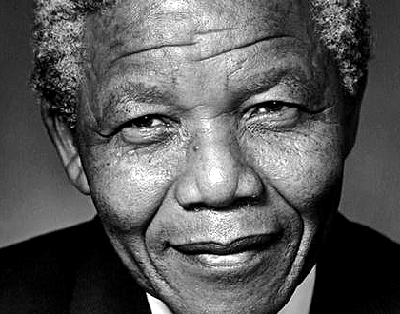
“Poverty is not an accident.
Like slavery and apartheid,
it is man-made and can be removed by the actions of human beings.”
-- Nelson Mandela

Slide 16
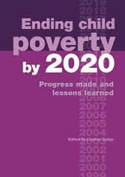
We were inspired by the promise of a goal oriented approach
Great Britain adopted the national goal of eliminating child poverty by the year 2020
evidence-based strategies were adopted up to the scale of the problem
a robust evaluation and tracking system was adopted to:
evaluate progress in real time
identify what is working
. . . and what is not
. . . and recommend policy shifts

Slide 17
What the British Experience Shows
26.1
22.5
18.9
12.3
10.6
2010
Notes:
Graph is from Fighting Childhood Poverty in the US and UK: an update 2010 Smeeding nad Waldfogel. Additional data is from Living standards, poverty and inequality in the UK: 2012, Institute for Fiscal Studies UK Commentary by Cribb, Joyce and Phillip Page 76.

Slide 18
CAMPAIGN PRIORITIES
1. Set child poverty reduction goals, equity goals, and timelines.

Slide 19
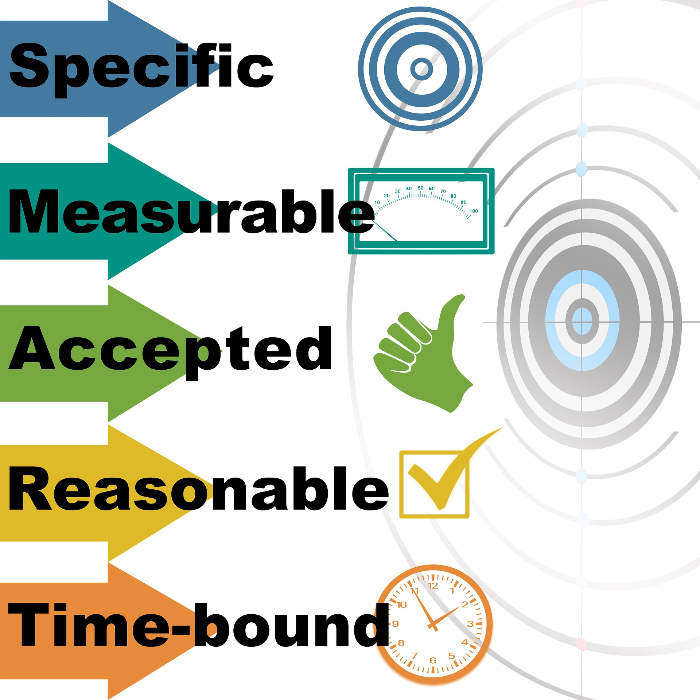
2. Develop accountability mechanisms:
A robust and independent tracking and evaluation capacity, trusted by all sides, which will make clear assessments of what is working, and what needs to change (e.g. the creation of a Legislative Child Poverty Bureau).

Slide 20
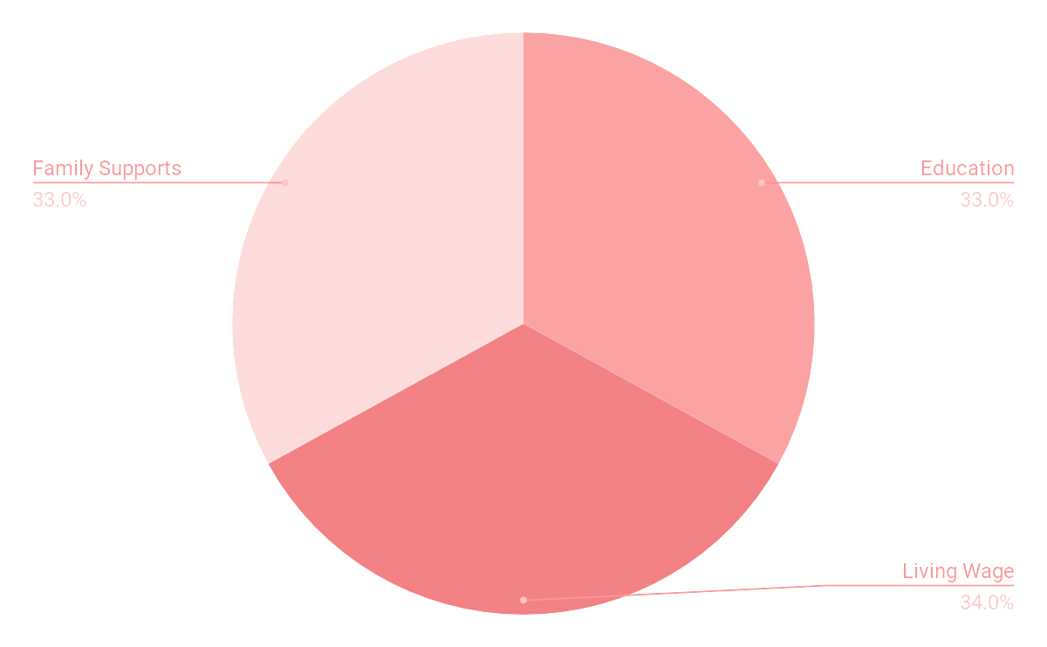
3. IMPLEMENT MULTI-SECTOR, EVIDENCE BASED STRATEGIES AT THE SCALE CAPABLE OF ACHIEVING THE POVERTY REDUCTION GOAL.

Slide 21
THESE MULTI-SECTOR, EVIDENCE BASED STRATEGIES INCLUDE
Employment and Income:
Help people get well-paying jobs.

Slide 22
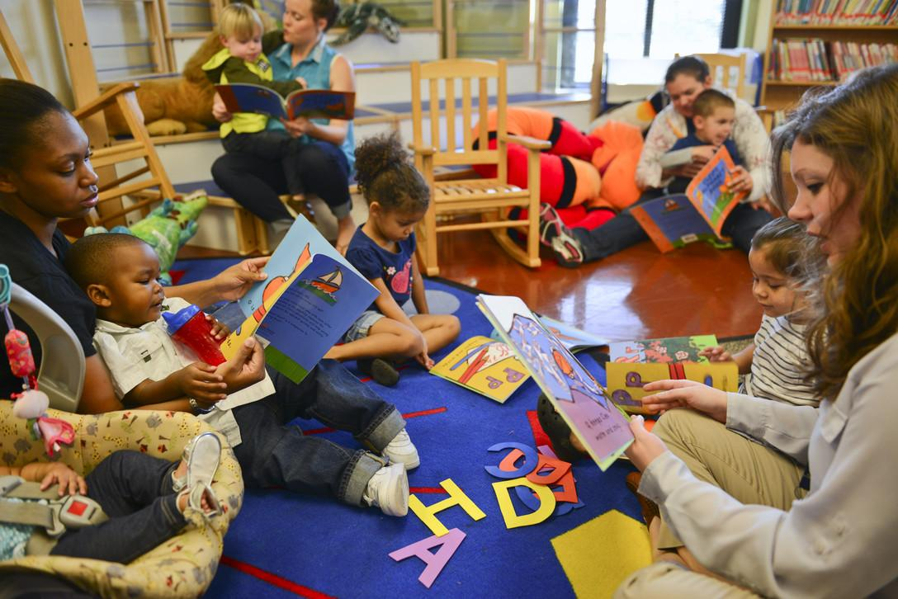
B. HIGH QUALITY EDUCATION:
Increase public investment in underfunded stages of education, particularly in the early years.

Slide 23
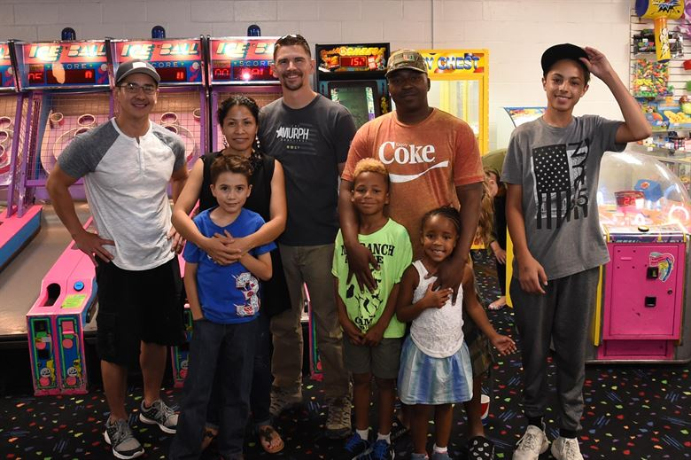
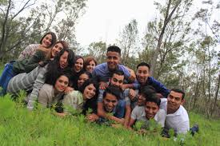
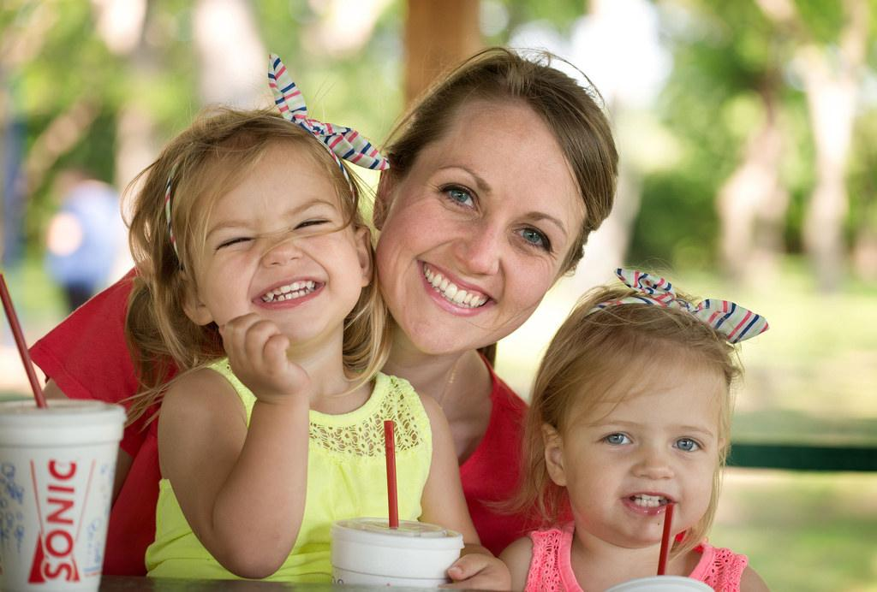
C. STRENGTHENING FAMILIES:
Deepen relationships and build social capital.

Slide 24
PRIORITY 4
Measure progress and adjust as necessary.

